Slide 1
Implementing PID
Dr. Steven Swanson
CSE176e/276e
swanson@cs.ucsd.edu

Slide 2
To add
Discuss different ways they can control their quad
Pitch/roll -> rate of change of angle
Pitch/roll -> angle of attack
Pitch/roll -> velocity
Pitch/roll -> position
Throttle -> throttle
Throttle -> rate of climb
Throttle -> altitude
Discuss higher-order control
How to integrate GPS
How to integrate barometer

Slide 3
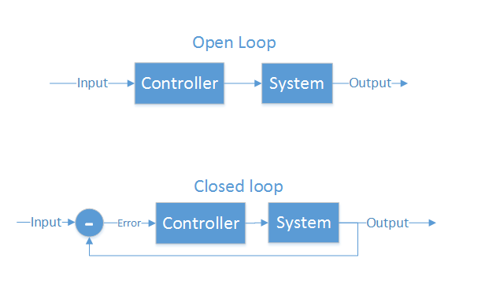
Control Theory Basics
Making a physical system do what you want
Open loop - cannot see the system’s output
Motor controllers
LCD/LED/CRT screens
Closed loop – measures output, make corrections
Autopilot
Cruise control
Our quadcopter

Slide 4
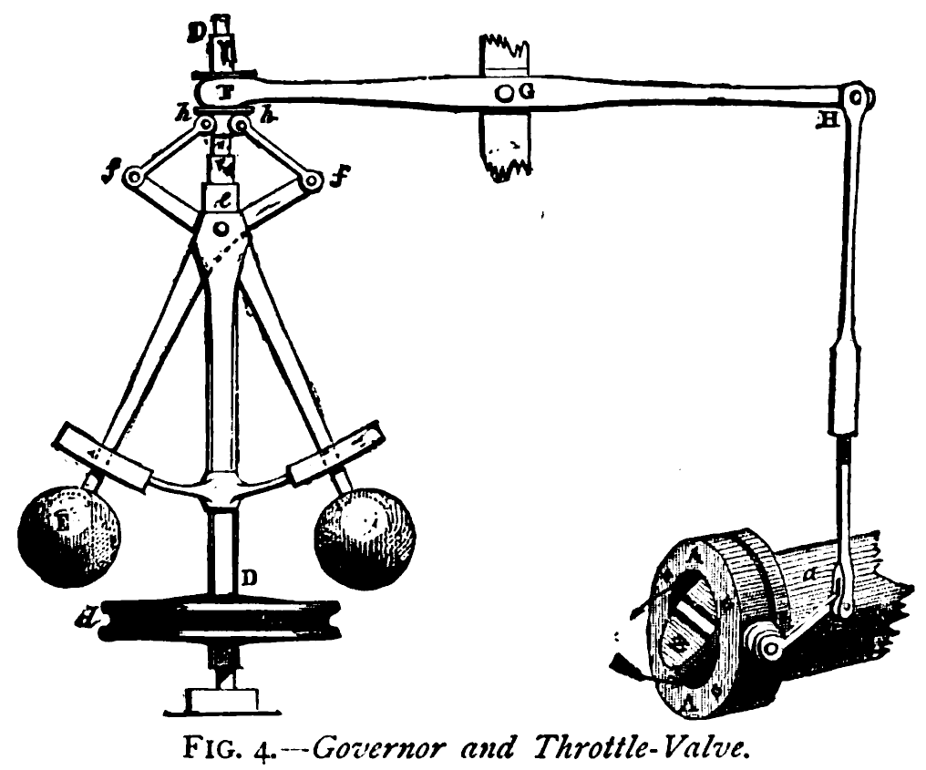
PID: The Usually-Good-Enough Controller
Make a system follow a set point
“Proportional, Integral, Derivative”
A brief history:
1788 - James Watt’s flyball governor (P)
1837 - Louis Molinié hydraulic regulator (PI)
1857 - H.N. Throop marine engine governor (PD)
1911 - Elmer Sperry, ship steering (PID)

Slide 5
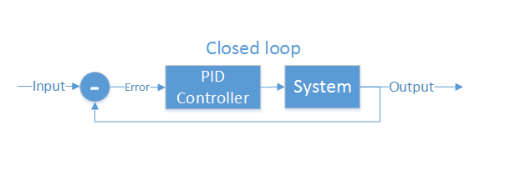
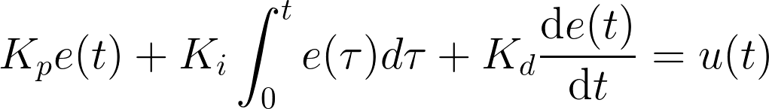
PID Details
PID is the most common closed loop controller
Proportional: Directly correct error
Integral: Account for steady-state error
Derivative: Dampens response, avoids overshoot

Slide 6
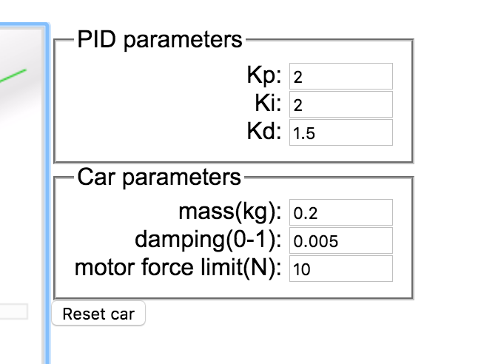
Example
https://sites.google.com/site/fpgaandco/pid-demo

Slide 7
This Lab
Implement a mechanism to tune the PID values from your remote
Implement and tune PID for Yaw
You yaw stick on the remote should control the yaw rate
You can use the gyro output directly.
Implement and tune PID for Pitch
Your Pitch stick should control the pitch angle
Use the output of your complimentary filter
Demonstrate that you have achieved control hanging upside (yaw) or on the test stand (pitch)

Slide 8
Implementation
NOTES:
Where to get the derivative?
Integral windup
Pay attention to rate (hz)
Relative scale of inputs and outputs
Should you include the time step?
Make sure timestep is consistent

Slide 9
How important in speed?
The key number is how many times/sec your PID loops (Hz)
The internet suggests > 100Hz (10ms/cycle) is necessary for stable flight.
My non-optimized code runs at 400Hz (2.5ms/cycles)
Action | Latency (ms)
Reading IMU | 7.360
analogWrite() | 0.012
analogRead() | 0.104
Integer PID (one channel) | 1.880 (531Hz)
FP PID (one channel) | 1.888 (529Hz)
AHRS getOrientation() | 1.860
rfWrite() 16 bytes | 0.812
Serial.write(“a”) | 0.906

Slide 10
Remote Software Path
Scale gimbal readings (-512-512 for P,R, Y; 0-1023 for T)
“deadband” avoids noise near the mid point
If P, R, or Y is near 0, make it zero.
Performance is not critical 10-20Hz updates is more than enough.

Slide 11
Quadcopter Datapath

Slide 12
The Mixer
Keep it simple
Set all motor outputs to the throttle
Add and subtract your PID values for each axis
Do it symmetrically so that the other axes are not affected
E.g., Adjust pitch by adding one CW and one CCW motor and subtracting from on CW and CCW motor

Slide 13
Tuning Suggestions
Tuning Order
Tune P – there will be a lot of oscillation and bouncing around on the test stand
Tune D – Dampen the oscillation
Tune I – remove offset error (beware the windup)
Reading the oscillation
Get a feel for the rate of oscillation you see with just P.
Higher-frequency oscillation is usually too much D.
Lower-frequency oscillation is usually too much I.
Higher P and I values tend to increase responsiveness
It reacts more aggressively to error
Higher D values tends reduce responsiveness
It can “overdamp” the the quadcopter and prevent it from reaching the set point.

Slide 14
PID Pitfall: Integral Windup
The integral term accumulates error
If error is large for a long time, this value can grow very large
Possible causes (among others)
If I is 0, the quad won’t correct for steady-state error, so that error will accumulate
If the motors are off, the quad won’t correct error, so it will grow.
If you hold the quad so it can’t move, the sum will grow.
Solutions
Have the integral decay over time (sum = sum/2 + Error)
Reset sum to 0 when the throttle is off.

Slide 15
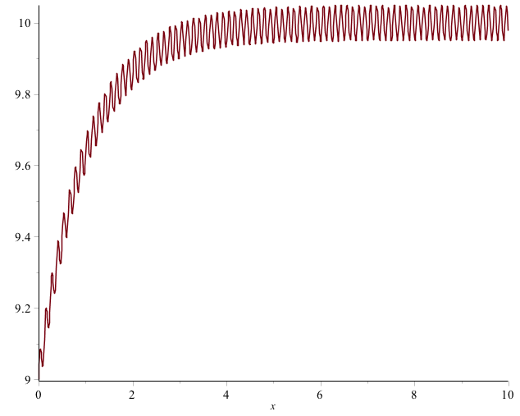
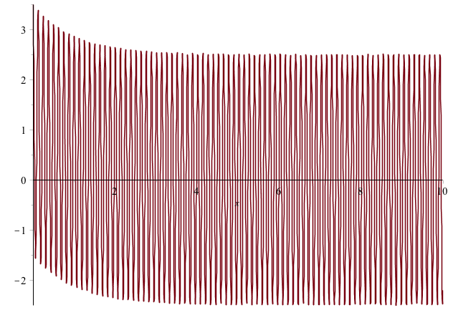

PID Pitfall: Derivative Noise
The D terms is susceptible to noise
Configure your IMU filters wisely
Error term with vibration
Derivative term goes crazy

Slide 16
PID Pitfall: Complexity
Your PID implementation does not need to be complicated.
Simplicity is your friend.
So is careful debugging.
Assume nothing!
My PID Implementation
My Complimentary filter Implementation

Slide 17
PID Pitfall: Not Preparing Your Infrastructure
Invest in debugging and monitoring code
It will save you loads of time
For instance
Make your data easily plottable
Make it easy to configured what’s plotted
Make your remote easy to use
Send useful telemetry.
Make it easy to adjust filter tuning.
Save PID values to EEPROM
Make it easy re-check the basics
IMU measurements
Filter output
Calibration
Debugging Code
My Complimentary filter Implementation

Slide 18
PID Pitfall: Taking too Long
If your loop() takes too long, PID response will be sluggish.
Your loop rate should be something near 100Hz (10ms/iteration)
Possible causes
Too much Serial.print()
To many packets (they cause interrupts)
To much complex math.
Solutions
Increase serial port rate (at least 115200 should be possible)
Have your remote transmit no more than 10 times per second.
Track your loop rate with millis().

Slide 19
Controlling Pitch
Pitch forward
More thrust to the rear
Less to the front
Pitch backward
Less thrust to the rear
More to the back

Slide 20
Controlling Roll
Pitch Left
More thrust to the right motor
Less to the left
Pitch Right
More thrust to the left motor
Less to the Right

Slide 21
Controlling Yaw
Rotate CCW
More thrust to the CCW motors
Less to the CW
Rotate CW
More thrust CW motors
Less to the CCW

Slide 22
PID Tuning Demo
Dr. Steven Swanson
CSE176e/276e
swanson@cs.ucsd.edu

Slide 23
Pitch Axis PID Tuning and Checklist
Dr. Steven Swanson
CSE176e/276e
swanson@cs.ucsd.edu

